Slide 1
Date: 02.05.24
Vehicle to Vehicle Visible Light Communication
Saransh Gautam
Supervised by: Dr. Rahul Singhal
Department of Electrical and Electronics Engineering

Slide 2
Introduction
With advent of EVs, there has been a trend in automotive industries to integrate advanced technologies in vehicles.
V2V communication systems have the potential to prevent accidents, reduce congestion, and improve traffic flow.
Advantages of VLC technology include immunity to electromagnetic interference, and compatibility with existing lighting infrastructure. It offers a promising alternative to traditional radio frequency (RF) communication methods.

Slide 3
Objectives
The primary objective of the project is to develop and implement a Visible Light Communication (VLC) system for Vehicle-to-Vehicle (V2V) communication in the automotive industry.
Key goals include establishing an efficient bidirectional communication between vehicles and optimizing data transmission speeds through the integration of VLC technology.

Slide 4
Current Progress
An End-to-End prototype of Full Duplex Bidirectional Visible Light Communication has been implemented using 4 Arduino Boards.
A Custom Communication Protocol was implemented that uses the ASCII encoding of characters for direct modulation of LED.
Integrated a JML-LV22754 5V LED strip to simulate a car's Daytime Running Lights (DRL) system for realistic vehicular scenarios.
Observed maximum distance of detection for different wavelengths of light.

Slide 5
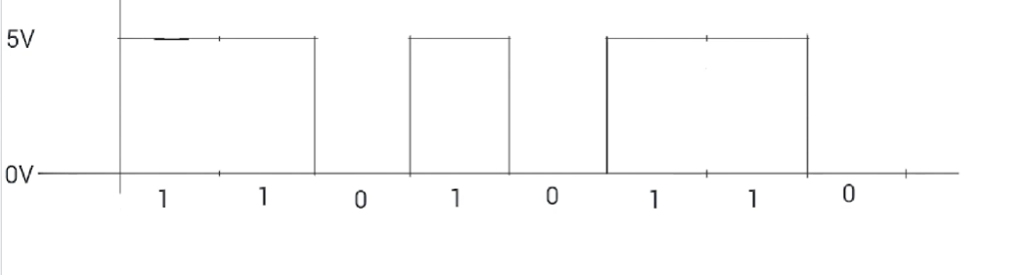
Communication Protocol: Tx
After 8 bits are sent, a HIGH output is transmitted for at least 1 period. If this was the last character to be sent in message, then the LED stays on. If it was not the last character, then the same protocol can be followed for the next character.
Default Operation: (ON)
The Transmitter Stays Low for 1 period before beginning the transmission of message (8 bits for 1 character)
Request Received to Transmit 1 character:
8 bits are transmitted according to ASCII for given character
Notes:
Important to note that the starting point of sending a character is HIGH OP and Falling Edge.

Slide 6
Communication Protocol: Rx
Waits or 1.5 Periods after detecting a falling edge
Detection stops till a next falling edge is encountered.
Starts detecting the message signal when it detects a falling edge.
Photodiode detects input 8 times after 1 Period each for 8 bits. The received bit is characterized as 0 or 1 based on a given Threshold
Notes:
Important to note that the starting point of sending a character is HIGH OP and Falling Edge.

Slide 7
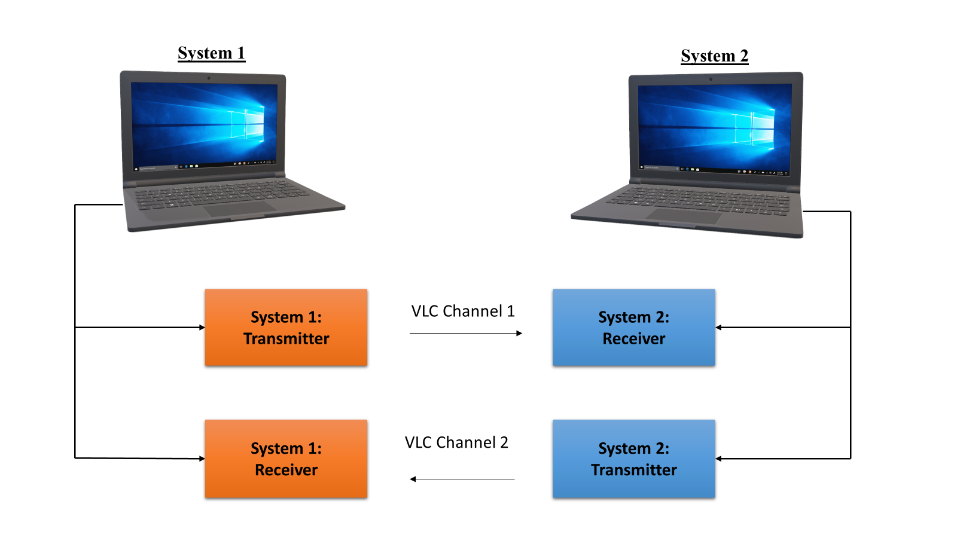
Setup for Full Duplex Bi-Directional Comm.

Slide 8
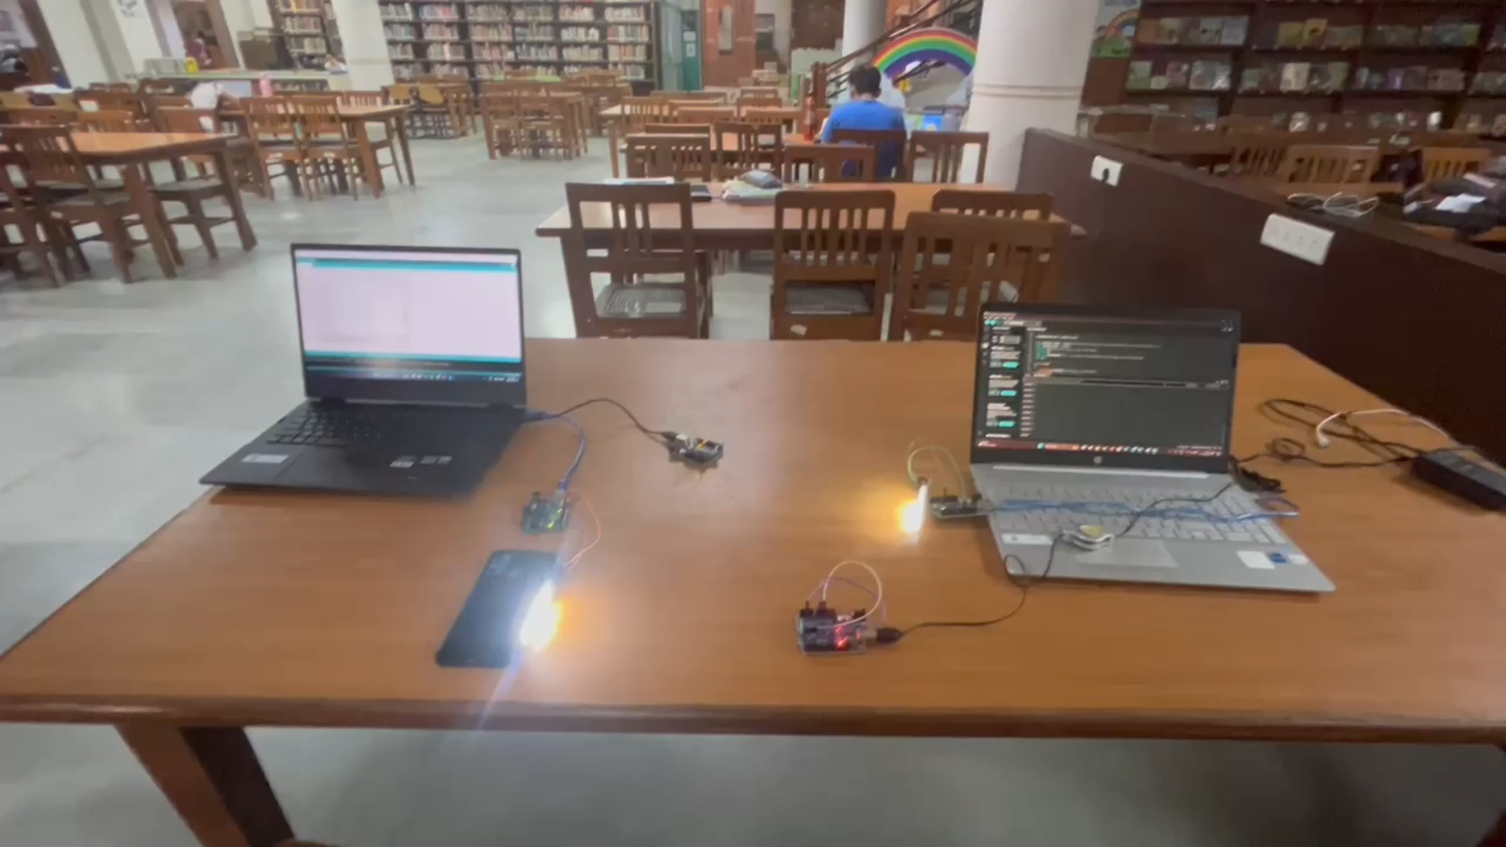

Slide 9
Direct LED Modulator for VLC transmitter
Here, we explore some ideas for designing a Direct LED Modulator to enhance the performance of the transmitter:
Pulse Width Modulation (PWM): Implementing PWM techniques can enable precise control over the intensity of light emitted by the LED array. By varying the duty cycle of the PWM signal, different brightness levels can be achieved, facilitating the encoding of binary data efficiently. This method offers flexibility in adjusting the modulation depth according to the specific requirements of the communication system.
Adaptive Modulation Schemes: Incorporating adaptive modulation schemes based on the ambient light conditions can improve the reliability of data transmission. By dynamically adjusting the modulation parameters such as modulation depth and frequency in response to changes in ambient light levels, the system can maintain optimal performance under varying environmental conditions. Adaptive modulation ensures robust communication even in challenging lighting environments.

Slide 10
Direct LED Modulator for VLC transmitter
Huffman Encoding: This encoding technique assigns variable-length codes to input characters based on their frequencies, with more frequent characters represented by shorter codes.
By utilizing shorter codes for commonly occurring characters and longer codes for less frequent ones, Huffman Encoding reduces the overall number of bits required to represent the data.
In the context of VLC, this means that more information can be transmitted within each light pulse, leading to increased data throughput and transmission efficiency.
Can be implemented through Trie data structures in C language.

Slide 11
Future Goals:
The following work can be done on the project:
Integration with a Car’s DRL System: We aim to enhance the functionality of these DRL lights beyond their conventional purpose of increasing vehicle visibility during daylight hours by including our VLC protocol in them.
Using Different Regions of Detectors for different channels: We aim to check if multiple channels can be created on the detector array in different regions.
Changing Angle: We will see how the changing angle between the sending LED and the receiving diode changes the accuracy of received message.
Multi – Channel Communication: We can utilize the different wavelengths within white light to increase communication speed and accuracy.

Slide 12
Thank You

